Slide 1
A Brief Foray Into Philosophy

Slide 2
Philosophy Terminology
What is true is metaphysics
What is knowledge is epistemology
Logic is the rules of dealing with information
Values are axiology

Slide 3
metaphysics
epistemology
What is knowledge based on
What is real
How can thoughts be organized
What is moral
axiology
logic

Slide 4
Read Ornstein and Levine

Slide 5
Idealism
Plato, Berkeley, Many Religions
metaphysics
epistemology
Unchanging universal mind
Realizing latent ideas
Deductive from universals
Absolute and eternal
axiology
logic

Slide 6
Realism
Aristotle, Locke, Hume
metaphysics
epistemology
An external material world
Sense experience
Both deductive and inductive
Natural law
axiology
logic

Slide 7
Pragmatism
Pierce, Dewey, James
metaphysics
epistemology
Interaction of an individual with the world
Constant examination of change
Relative and situational
Inductive
axiology
logic

Slide 8
Existentialism
Kierkegaard, Nietzsche, Sartre
metaphysics
epistemology
Human being as creator of his or her own existence
Total freedom of choice and total responsibility for choices
axiology
logic

Slide 9
Validity
When is research valid?

Slide 10
Validity
Research is valid when it is an accurate and generalizable description of the phenomenon being investigated.
Generalizable beyond the study sample
Accurate
The study design and execution do not impact the results
Instrument validity

Slide 11
Validity
Research is valid when it is an accurate and generalizable description of the phenomena being investigated.
Over the history of research we have adopted rules to establish validity of research.
Follow the rules and you will have valid research.

Slide 12
Research
An observable world exits outside of me.
I can use my five senses to gather information about that world.
I can apply a logic (rules) to understanding that information.

Slide 13
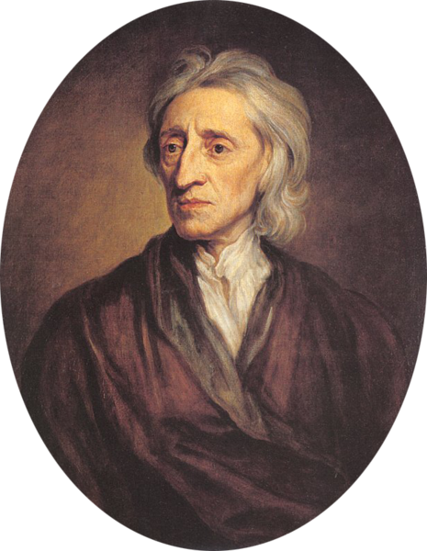
Empiricism
Locke, J. (1689). An essay concerning human understanding. Retrieved from https://ebooks.adelaide.edu.au/l/locke/john/l81u/
Tabula rasa
Understanding the world through the senses
Applying scientific method

Slide 14
Rules of Research
Scientific Method
Formulate a question
Hypothesis
Prediction
Testing
Analysis

Slide 15
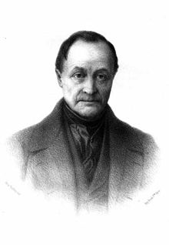
Positivism
Comte, A. (1856). A general view of positivism. Retrieved from https://archive.org/details/ageneralviewpos00comtgoog
Positivism (after Locke)
Sociology (empiricism for the social)

Slide 16
Philosophy of Positivism
Metaphysics: a world exists outside of oneself that can be observed
Epistemology: knowledge is information gathered through the senses
Logic: analytical reasoning
Axiology: improvement of society is valuable

Slide 17
The Critique of Positivism
You can never know universal truth but you can reject false belief
Popper K. (1959). The logic of scientific discovery. Eastford, CT: Martino Fine Books.
Knowledge changes in paradigm shifts: knowing by consensus
Kuhn, T. (1962). The structure of scientific revolutions. Chicago IL: Chicago University Press.

Slide 18
Post-Positivism
Interpretivism: Knowledge is gained through interpretation
The researcher cannot be separated from the research
Research can serve many purposes
Locating rationality in structures of interpersonal linguistic communication
Habermas, J. (1984). The theory of communicative action. Boston, MA: Beacon Press

Slide 19
Philosophical Research Validity
Idealist: latent truths are revealed
Realist: accuracy in interpretation of the external world
Pragmatist: results are socially valuable
Existential: results help individuals make personal decisions

Slide 20
Subjectivity, Positionality, and Reflexivity
Just a few thoughts. We need to keep coming back to this.

Slide 21
Notes:
Four arrows.
Well, this is something quite different if you graduated from Michigan State.
Notice how you can see the arrows or see the M but not both at the same time. Our minds sort information in predictable ways. That sorting is often based on interest (what is important). If an interest is strong enough that will keep us from seeing things in other ways.

Slide 22
Research
In research we are always making decisions about what we see.
That means, because of those decisions, there are things we will not see.
That means that research results will ALWAYS be biased by the choices you make.
Part of a researcher’s job is to make that bias as obvious as possible.

Slide 23
Skylark Shores Resort
Notes:
How to improve our data gathering
Could use sound
Could use multiple points of view
Could use motion or change over time
Or we could be more careful about the quality of the data provided

Slide 25
I know I got the horizon crooked but it just looked better to me with the fence horizontal.
Buy a fence from Bob’s Fencing Supply

Slide 26
Research
A research report is one representation of reality.
Our job is to give the best representation we can.
That includes a description of the purpose of the representation.
Sometimes there are limitations to the representation and we have to own up to those.

Slide 27
Subjectivity
The perceptions, experiences, expectations, personal or cultural understanding, and beliefs specific to a person that influence and inform an individual’s judgments about truth or reality.

Slide 28
Subjectivity
In the positivist approach, study design is used to eliminate subjectivity in order to be more confident about the truth of the findings.
In the non-positivist approach, subjectivity is emphasized to allow the reader of research to make his or her own judgement about the truth of the findings.

Slide 29
Positionality
I see what I am disposed to see.
When I see something it means that I do not see other things. (figure/ground)

Slide 30
The Influence of Positionality
Research design
Data gathering
Analysis

Slide 31
Reflexivity
Since study design, data collection, and analysis are to some extent a product of the researcher’s positionality, it is crucial to research that a researcher makes the influences on subjectivity as apparent as possible.

Slide 32
Reflexivity
In quantitative research we do this by eliminating as many influences of the researcher as possible.
Attention to validity and reliability usually presented in the methods section
In qualitative research we do this by including rigorous self-reflection on the research process in the final report.
It can be anywhere in the report

Slide 33
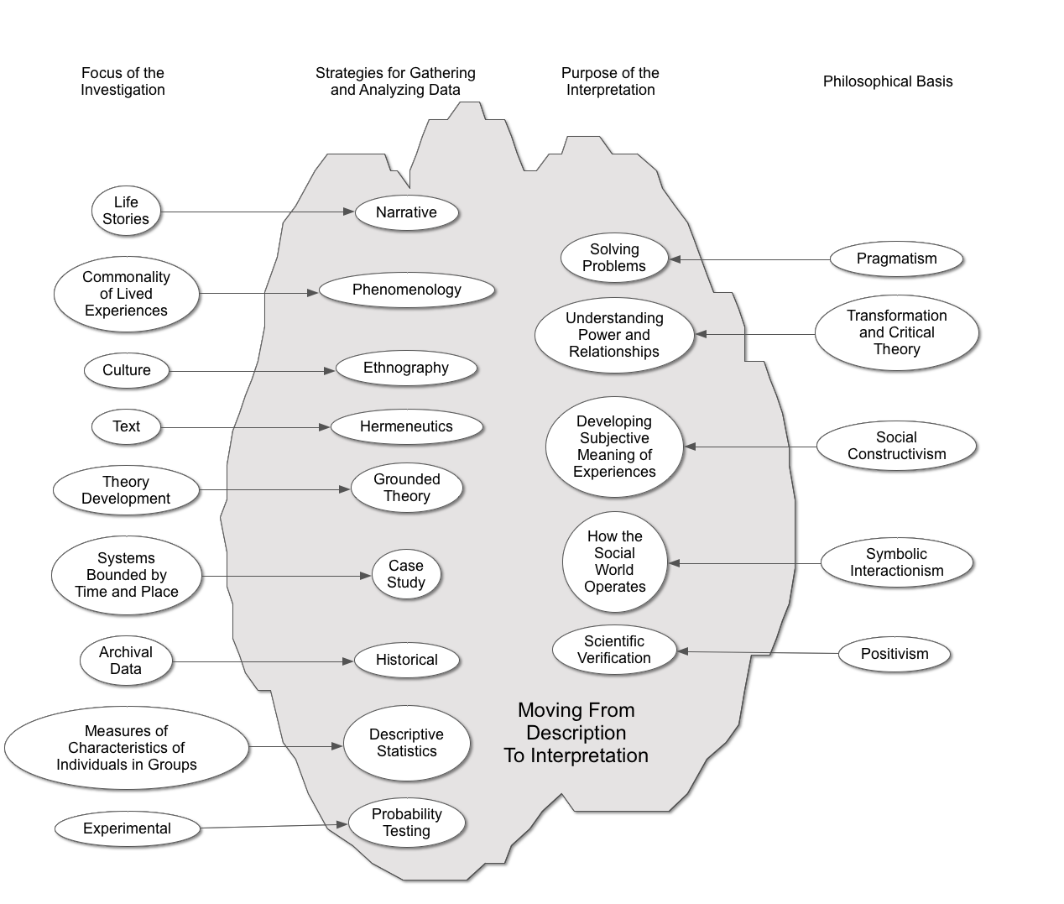

Slide 34
Qualitative Interpretive Frameworks
Social Constructivism
Understanding lived experiences
Pragmatism
Determining best outcomes
Critical Theory
Facilitating emancipation
Interpretivism

Slide 35
Why This Is Important
Positionality
How you gather and analyze data is influenced by what you intend to do with the results.
different purposes—different processes
You have to be careful that you get the right study design for the right purpose.

Slide 36
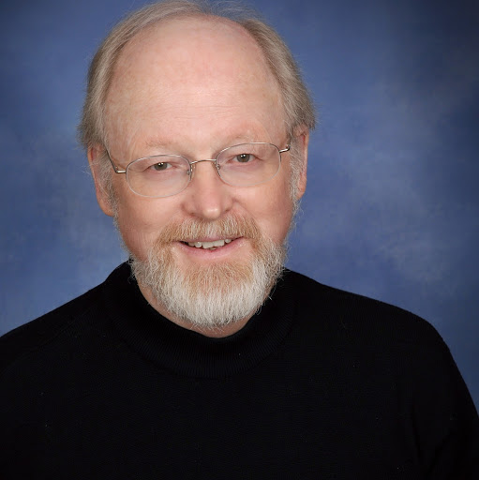
John Creswell
University of Nebraska
Creswell, J. W. (2013). Qualitative inquiry and research design: Choosing among five approaches (4th ed.). Los Angeles, CA: Sage

Slide 37
Creswell’s 5 Methods
There are many, many more and many variations of each.
There is a continuum of the degree to which specific procedures should be used with each method. Creswell tends to be in the middle.

Slide 38
Narrative Research
Interpretive framework
Usually social constructivist
Purpose
Examining experience through personal stories
Data
The stories from one or a few respondents
Interviews but could include other forms
Analysis
Usually analyzed thematically (coding)

Slide 39
Phenomenological Research
Interpretive framework
Usually social constructivist
Purpose
Establishing the shared essence of a phenomenon through lived experience
Data
Exploration with a small group
Interviews
Analysis
Usually analyzed thematically (coding)
Bracketing (removing influences of prior experience)

Slide 40
Grounded Theory Research
Interpretive framework
Usually social constructivist
Purpose
Generation of a unified theoretical explanation
Data
Exploration of processes over time
All possible sources
Analysis
Coding categories
Constant comparative

Slide 41
Ethnographic Research
Interpretive framework
Usually social constructivist
Purpose
Generation of shared patterns within a group (culture)
Data
Examines social organization through fieldwork
All possible sources
Gathering of direct quotations
Analysis
Usually analyzed thematically (coding)

Slide 42
Case Study Research
Interpretive framework
Usually social constructivist
Purpose
Generation of assertions about a case
Data
Examines an individual or a small group usually
All possible sources
Analysis
A case description

Slide 43
How about pragmatism and critical theory?
Narrative
Phenomenological
Grounded theory
Ethnographic
Case study

Slide 44
A few other thoughts …
Hermeneutics (analysis of texts)
Hermeneutical circles
Descriptive statistics
Summaries of characteristics of individuals in groups
Historical

Slide 45
Creswell’s General Thoughts About Qualitative Research
Time
Complex data analysis
Lots of writing
Methods are not necessarily established for each kind of research

Slide 46
Creswell’s Process
Think about assumptions
Start reading the literature
Gather data from a variety of sources
Analyze
Validate
Report in an engaging style

